Slide 1
How to Build a Generative AI Application on AWS
Generative AI on AWS
Chakravarthy Nagarajan, Principal ML Prototyping SA
Katie Standish, Senior Program Manager

Slide 2

Agenda
Moving from Notebook to application
Well Architected – Best practices
Reference Architecture
Solution Components
Business Use Case
Implementation Details
Demo
Conclusion

Slide 3
Notebook to application in Production
PoC
Prototype
Pilot
Production

Slide 4
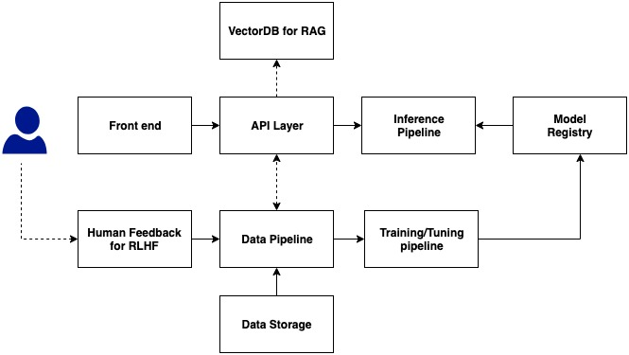
Conceptual Fundamentals for Deploying LLMs on AWS

Slide 5
What does it take to build an application on AWS?
AWS Well-Architected Pillars

Slide 6
Operational Excellence
Application programmable Interface(API) layer with accepted Input and output formats.
Choice of AWS service - Amazon Sagemaker Jumpstart or Amazon Bedrock or self-managed.
LLMOps using Amazon Sagemaker pipeline, Apache Airflow or Kubeflow with Model registry.
LangChain – Choose an appropriate Chain.
Continuous model improvement with Fine Tuning.
Application monitoring using Amazon Cloudwatch and AWS CloudTrail.
Model evaluation metrics – BLEU, ROUGE, Win Rate, etc.,
Asses the PIP repositories and Poetry for dependencies management.
Automate deployment using CDK, Amazon Cloudformation, etc.,

Slide 7
Security
Risk assessment
Analyze potential vulnerabilities against adversarial attacks, Prompt Injection, Prompt Leakage, etc.,
Mitigate by (1) Regex (2) Filtering and Validation techniques (3) Defensive approach using a custom Text Classifier.
Redact PII/PHI using Amazon Comprehend or any custom models.
Model transparency – HELM benchmark to measure Bias, Fairness, incompleteness, etc.,
Data protection
Choose the right dataset for tuning.
Data in rest shall be encrypted using AWS KMS.
Data in transit shall be encrypted using TLS 1.2 or higher.
VPC to isolate from internet traffic and VPC endpoints for Amazon S3 buckets.
Access Control – Use custom IAM roles and policies.
Static Analysis Security Testing(SAST) for Python vulnerabilities.

Slide 8
Reliability
Efficient data pipeline with metadata for vector database.
Multi AZ deployment.
Validation and error handling.
Retry and timeout mechanisms.
Right auto scaling metric

Slide 9
Performance Efficiency
Balance between Concurrency, Throughput, Latency and Scale.
Context tokens size and output response length.
Choose the right model, size and instance type for model deployment.
Enable Auto Scaling.
Choose the right architecture and memory for AWS Lambda.
Improve consistency and reliability using Retrieval Augmented Generation(RAG).
Prompt Engineering and Model Tuning Strategy.
Zero Shot / One Shot / Few Shot Learning.
Parameter Efficient Fine tuning.
Classic Fine tuning.

Slide 10
Sustainability and Cost Optimization
AWS Customer Carbon Footprint Tool to measure the estimated carbon emissions.
AWS Cost explorer to asses the overall solution cost.
Usage of AWS managed services.
Choose the right Instance type and model size.
Quantization to reduce the overall model size without compromise in accuracy.
Use Amazon EC2 spot instances in Amazon Sagemaker with Checkpoint/Restart for model Training/Tuning.

Slide 11
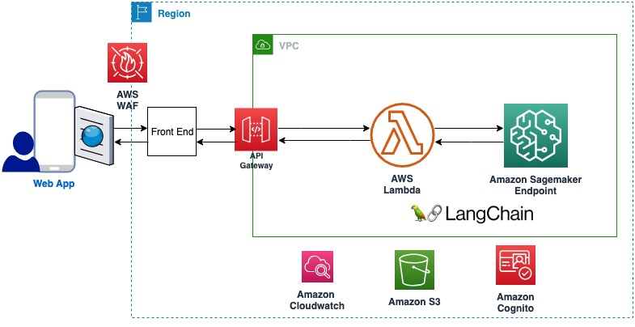
Reference Architecture Without RAG

Slide 12
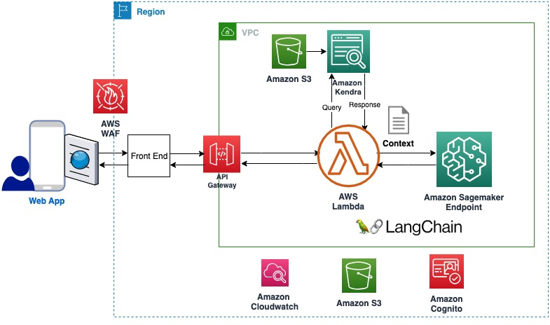
Reference Architecture with RAG

Slide 13
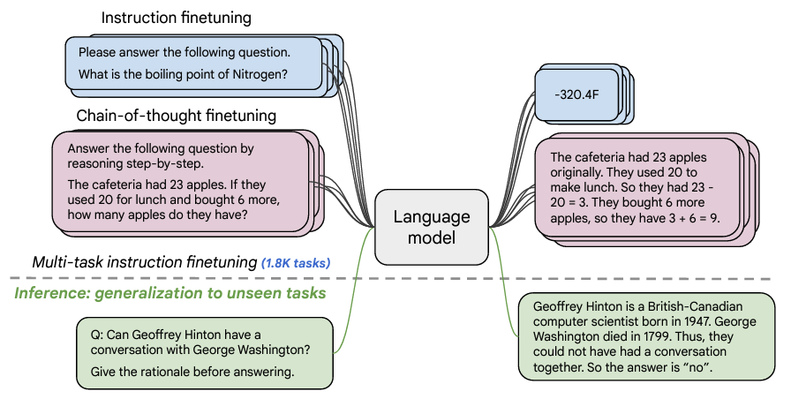
Solution Components
Model : Flan-T5-XL.
Source: HuggingFace.
3B params, 473 datasets,146 task categories and1836 total tasks.
Amazon Sagemaker Jumpstart
AWS CDK
LangChain Version: 0.0.137
Chain Type: Sequential
AWS Lambda Python: 3.10 with X86
Source: https://arxiv.org/pdf/2210.11416.pdf

Slide 14
Advanced parameters to control the generated text
Parameter | Description | Type
max_length | Model generates text until the output length (which includes the input context length) reaches max_length. | Positive Integer
max_time | The maximum amount of time you allow the inference to run for in seconds. | Positive Integer
num_return_sequences | Number of output sequences returned. | Positive Integer
num_beams | Number of beams used in the greedy search. | Positive Integer
no_repeat_ngram_size | Model ensures that a sequence of words of no_repeat_ngram_size is not repeated in the output sequence. | Positive Integer
temperature | Controls the randomness in the output. Higher temperature results in output sequence with low-probability words and lower temperature results in output sequence with high-probability words. If temperature -> 0, it results in greedy decoding. | Positive Integer
early_stopping | If True, text generation is finished when all beam hypotheses reach the end of sentence token. | Boolean
do_sample | If True, sample the next word as per the likelihood. | Positive Integer
top_k | In each step of text generation, sample from only the top_k most likely words. | Positive Integer
top_p | In each step of text generation, sample from the smallest possible set of words with cumulative probability top_p. (Between 0 and 1) | Positive Float
seed | Fix the randomized state for reproducibility. | Positive Integer

Slide 15
Business Use Case
Leverage Large Language Models (LLMs) to automate teacher workflow tasks in a Learning Management System with the following features.
Generating online course content.
Generating student discussion questions.
Creating online assessments.

Slide 16
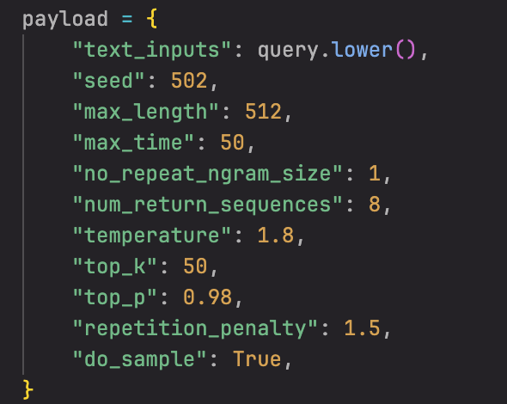
User Story #1
An instructor would like to build out a new online course and needs to generate content on a specific topic. The teacher inputs a prompt on the lesson topic, which is passed as a context to LLM to generate content.

Slide 17
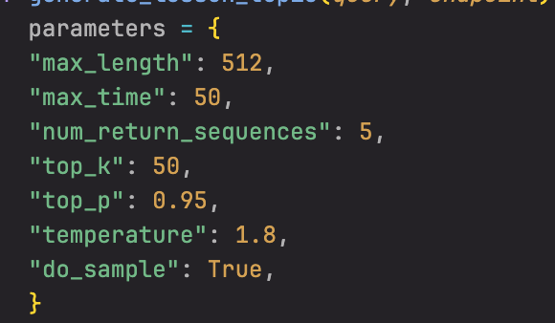
User Story #2
Students have reviewed the lesson content provided by the teacher. To ensure engagement, the instructor would like to have students participate in a discussion on the lesson topic. The instructor inputs a prompt, and the LLM generates five discussion questions based on the specific chapter/lesson as context.

Slide 18
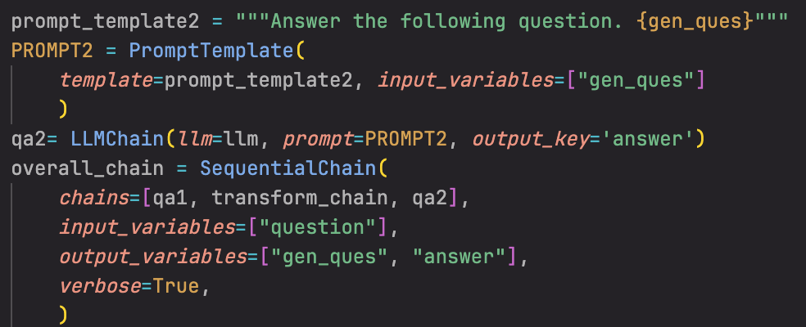
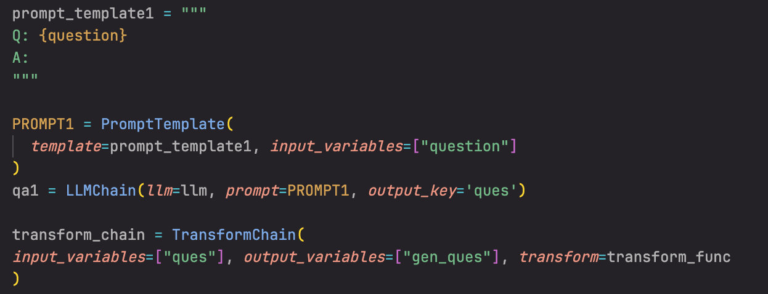
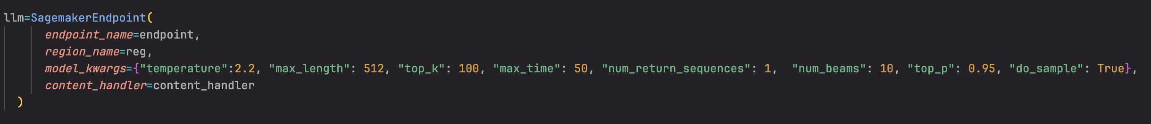
User Story #3a
All instruction has been completed. The teacher needs to evaluate student learning through an assessment. The instructor inputs a prompt, and the LLM generates a multiple choice question with four answer choices and a single correct response.

Slide 19
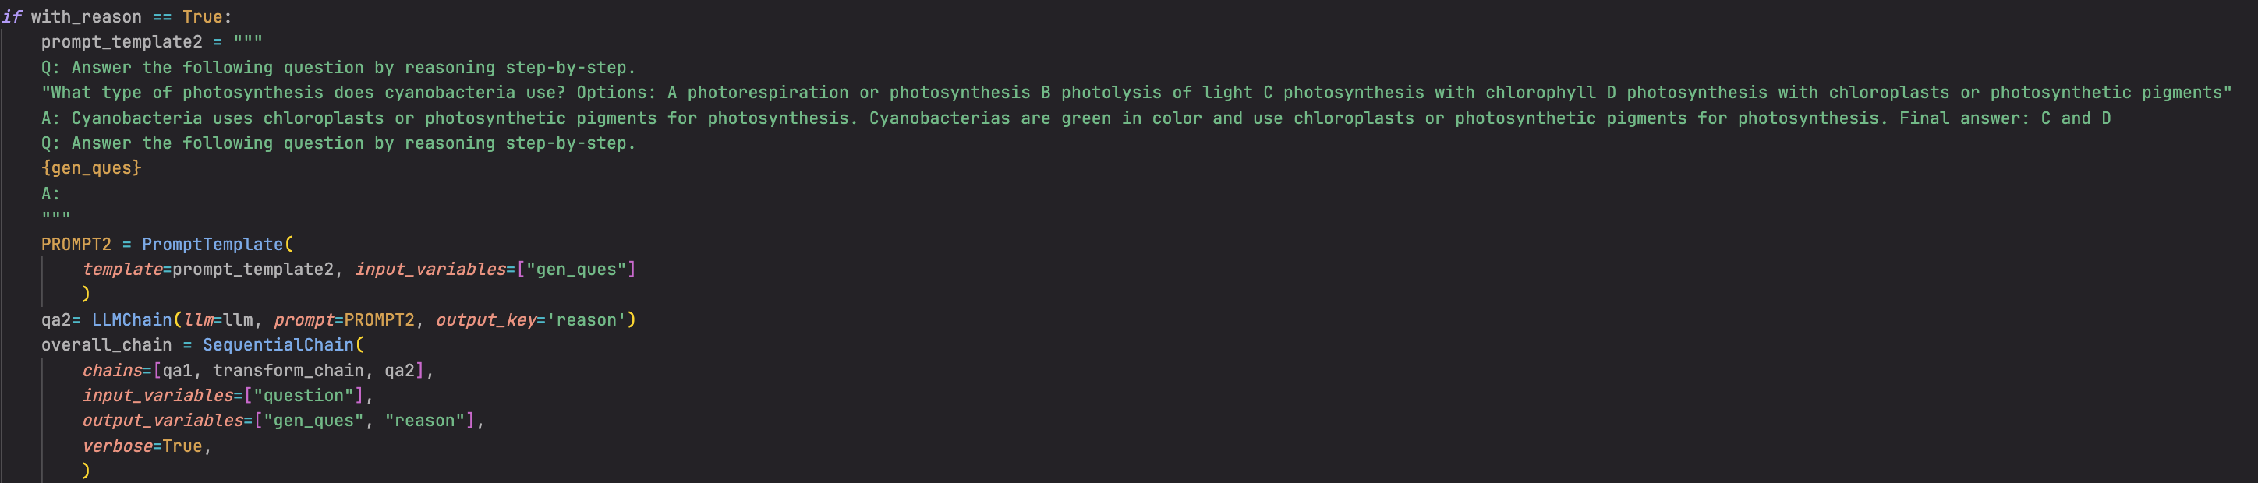
User Story #3b
All instruction has been completed. The teacher needs to evaluate student learning through an assessment. The instructor inputs a prompt, and the LLM generates a multiple choice question with four answer choices and a single correct response. The model also outputs a justification for the correct response.

Slide 20
Demo

Slide 21
Conclusion
Blog: https://aws.amazon.com/blogs/machine-learning/quickly-build-high-accuracy-generative-ai-applications-on-enterprise-data-using-amazon-kendra-langchain-and-large-language-models/
Samples: https://github.com/aws-samples/amazon-kendra-langchain-extensions/tree/main/kendra_retriever_samples

Slide 22
Thank You!

Slide 23

Scan QR for slides

